Slide 1
IS597 Final Project Presentation
Analysis Changes in Lending Data and Relationship with State Income
Instructor: John Weible
Group members:
Chuyang Li, Yuting Xu, Zheng Zhang
Date: 4th May 2022

Slide 2

Introduction of Lending Club
Platform for borrowing personal loan
Allow individuals to lend to other individuals
Fixed rate and payment
Up to $40,000

Slide 3
Lending Club Dataset Introduction
Time Period
Year of 2011
Format
10,000 rows 55 columns
Data Types
float64(17) int64(25) object(13)
id | name | Description | Non-null counts | Data Type
1 | emp_length | Length of Employment (Years) | 9831 | float64
2 | state | The 2-character code for state | 10000 | object
6 | debt_to_income | The debt-to-income ratio of the applicant | 9976 | float64
38 | loan_purpose | The purpose of the applicant | 10000 | object
40 | loan_amount | The amount needed by the applicant | 10000 | int64

Slide 4
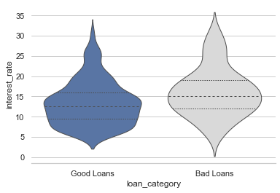
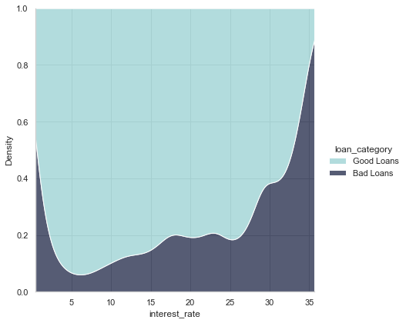
Finished Loans: Distribution
Interest Rate
Grouped Distribution
Proportion

Slide 5
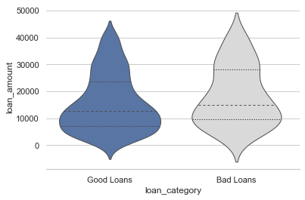
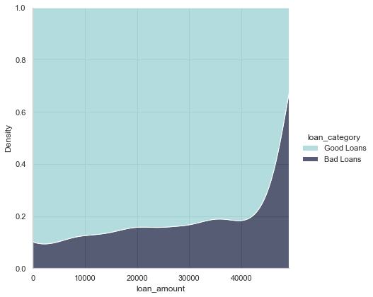
Finished Loans: Distribution
Loan Amount
Grouped Distribution
Proportion

Slide 6
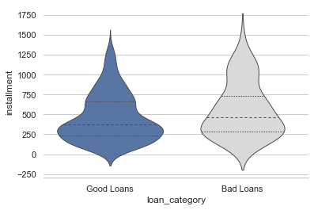
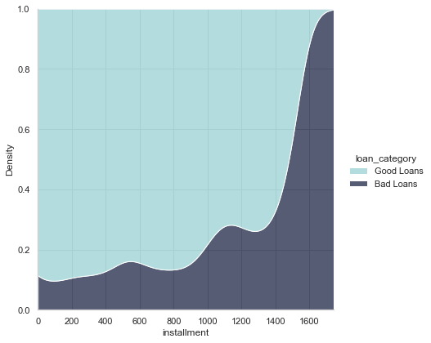
Finished Loans: Distribution
Installment
Grouped Distribution
Proportion

Slide 7
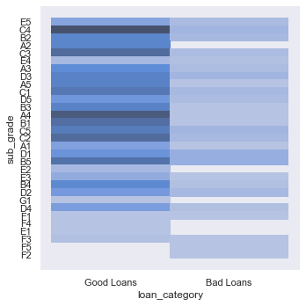
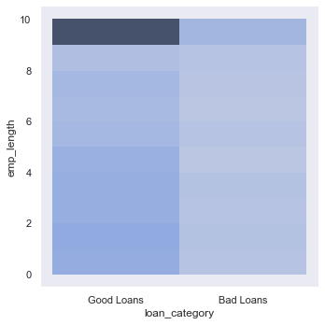
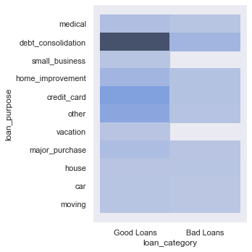
Finished Loans: Multi-Dimensional Distribution
Credit Grades
Length of Employment
Loan Purpose

Slide 8
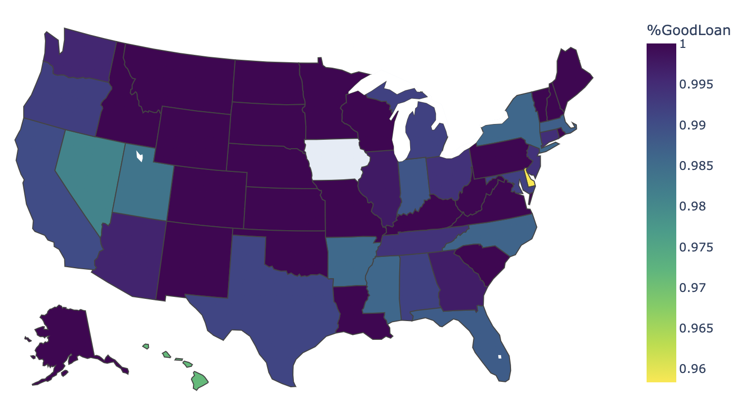
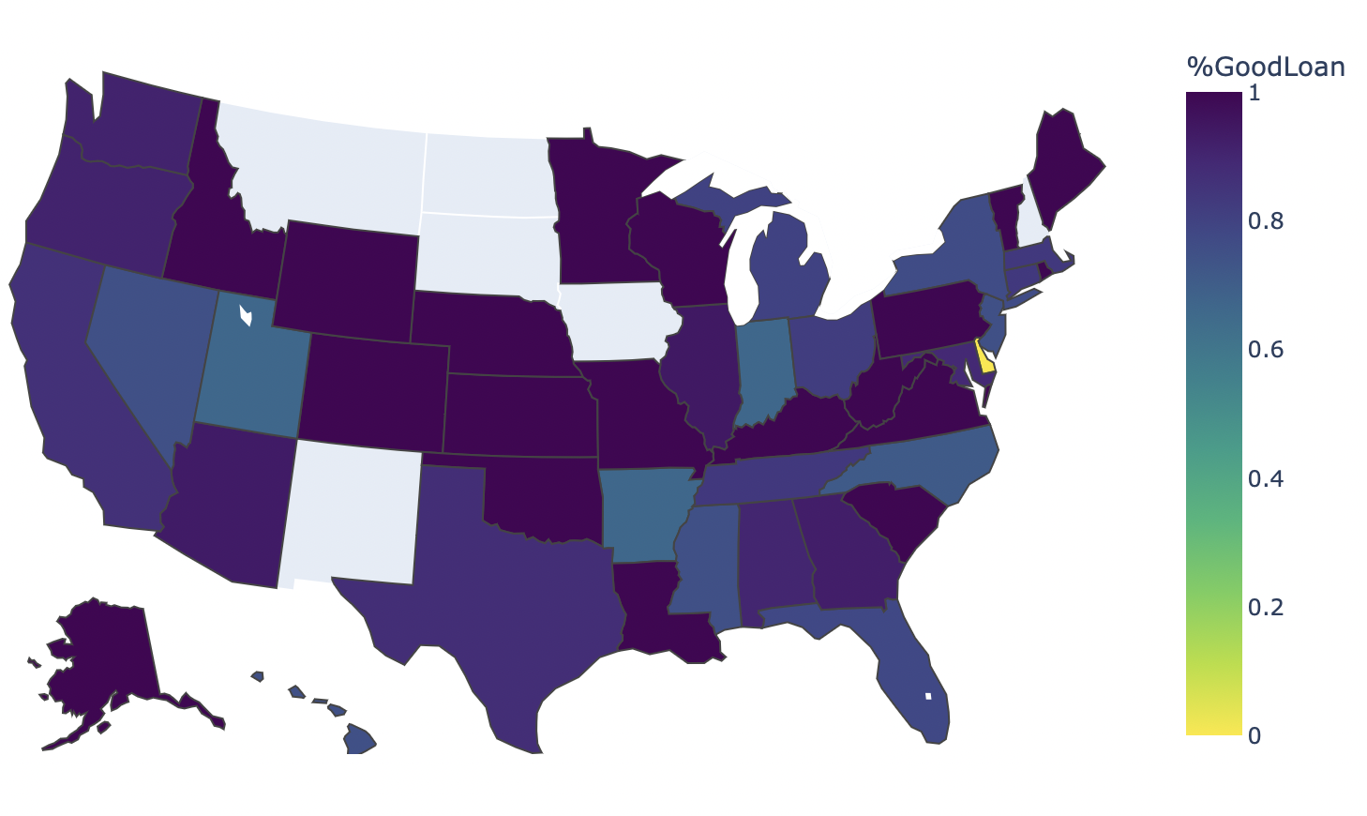
Geographical Distribution
All Loans
Finished Loans
Percentage of Good Loans > 95%
Most records are Ongoing Loans
No finished loans in certain states
Regions with higher percentage of “Good Loans”: Midwest

Slide 9
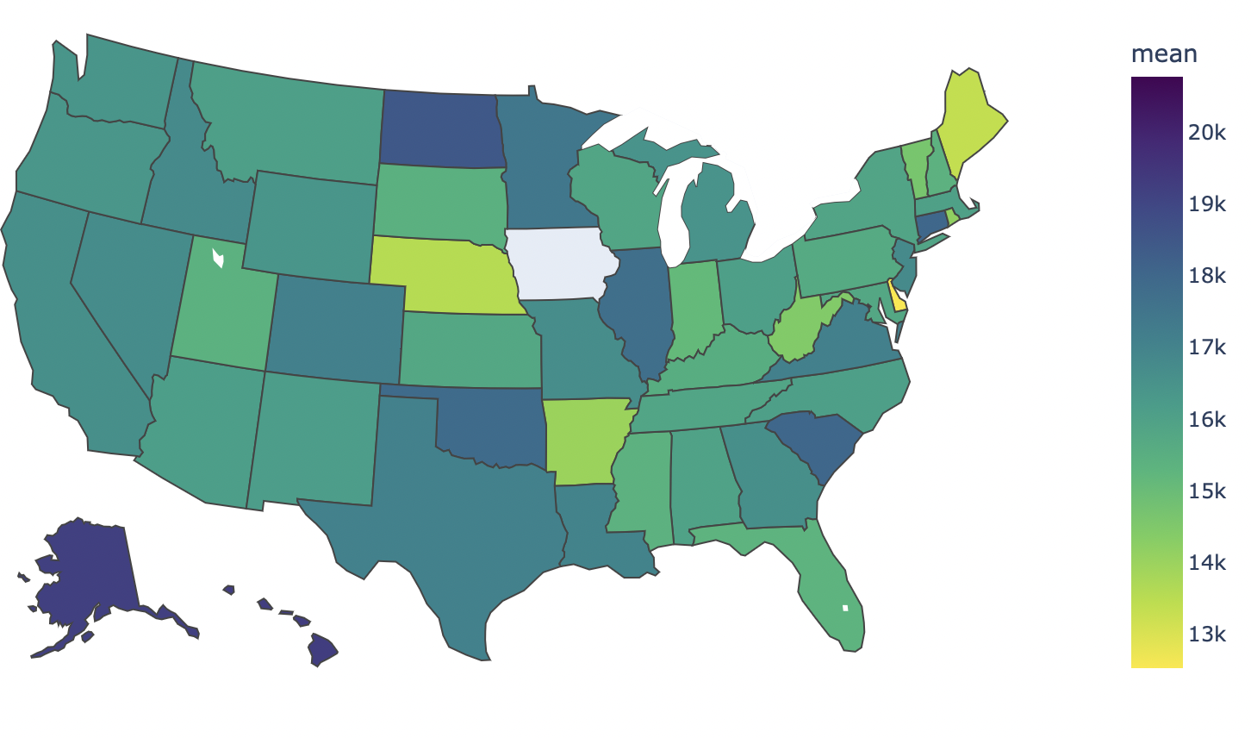
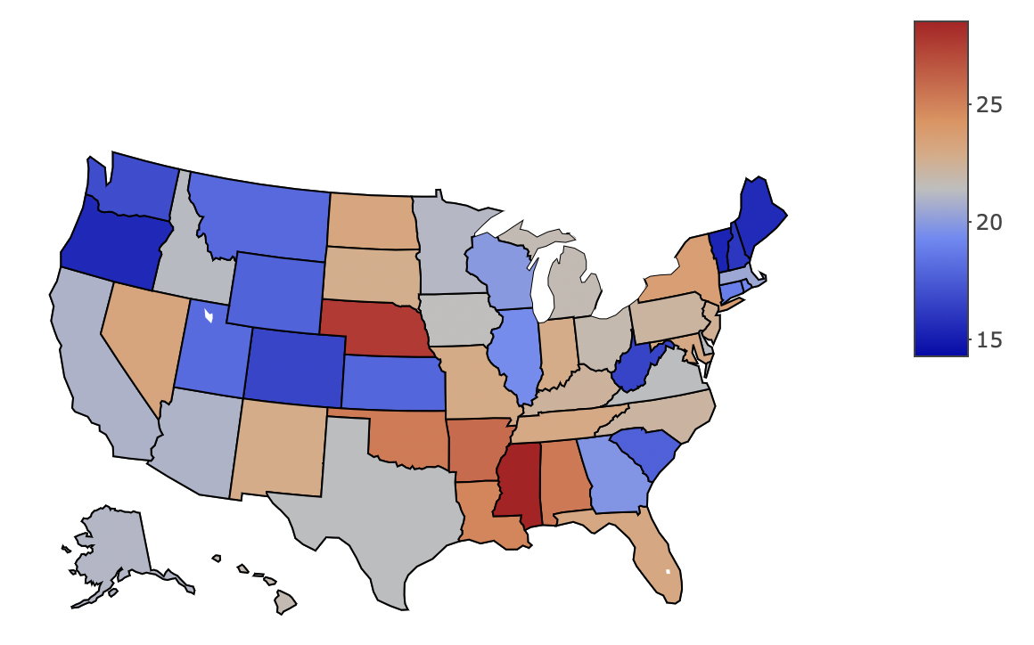
Geographical Distribution
Loan Per 10k Person
Loan Per User
Use Total Amount of Loans/Total Population of State * 10,000
Geographical Bias
Calculate average group by state
Most values between 15k and 17k

Slide 10
Hypothesis 1: The borrowers using Lending Club have worse economic situations than borrowers from all other lending resources
Indicators
Income; Debt; Income/Debt Ratio
Data
Survey of Consumer Finances
https://www.federalreserve.gov/econres/scf_2010.htm#EXCELDATEX
scfp2010
filter dp with debt
general borrower in 2010
borrower in 2019
general borrower in 2019
(adjusted to value of money in 2010)
scfp2019
filter dp with debt
adjust effect of inflation

Slide 11
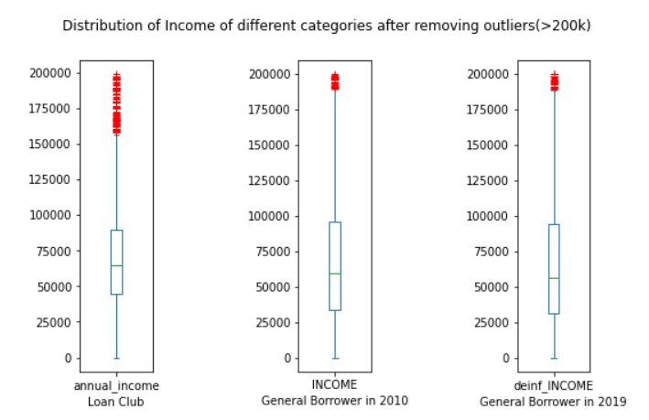
Hypothesis 1: The borrowers using Lending Club have worse economic situations than borrowers from all other lending resources
Income
upper boundary close to 90k
lower boundary of lending club higher than other two

Slide 12
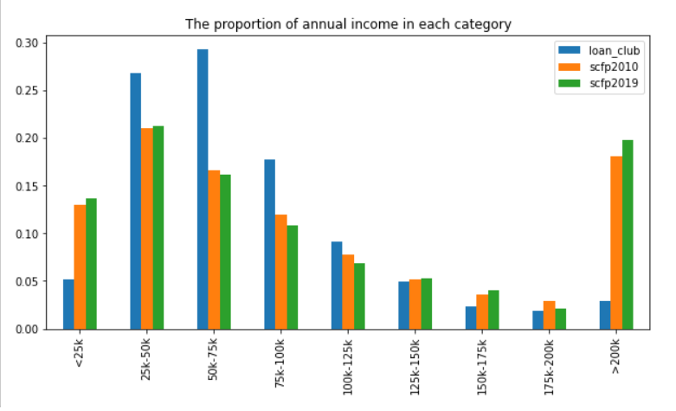
Hypothesis 1: The borrowers using Lending Club have worse economic situations than borrowers from all other lending resources
Income
club’s peak is at [25k-75k]
general borrower’s peak is at [0-50k], [>200k]
club has higher income distribution than general in the range of [25, 100k]
club has a smaller percentage of high-income group than general

Slide 13
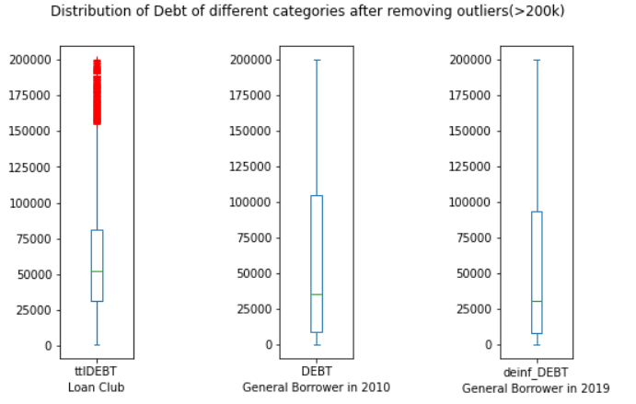
Hypothesis 1: The borrowers using Lending Club have worse economic situations than borrowers from all other lending resources
Debt
Debt = total credit utilized + loan amount
upper boundary of club lower than other two
lower boundary of club higher than other two

Slide 14
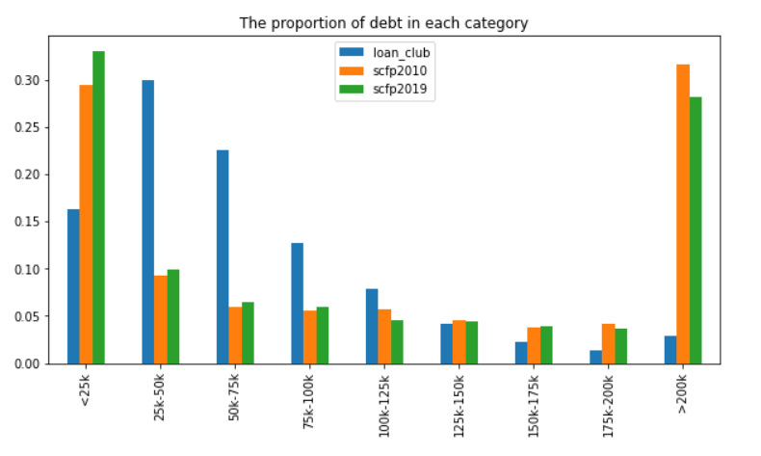
Hypothesis 1: The borrowers using Lending Club have worse economic situations than borrowers from all other lending resources
Debt
club’s peak is at [25k-75k]
general borrower’s peak is at [0-25k], [>200k]
club has higher debt distribution than general in the range of [25, 100k]
club has a higher debt amount proportion than general, beside the amount value greater than 200k

Slide 15
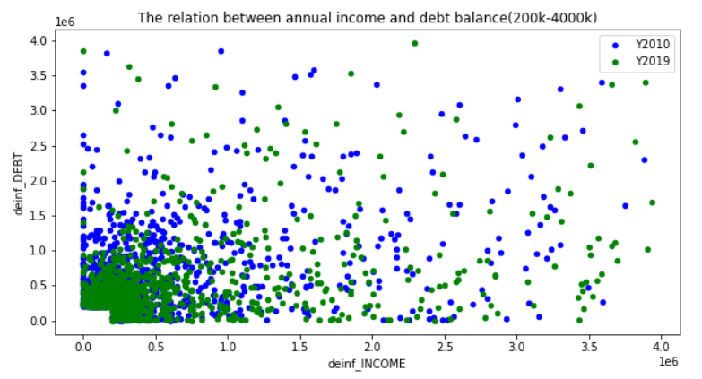
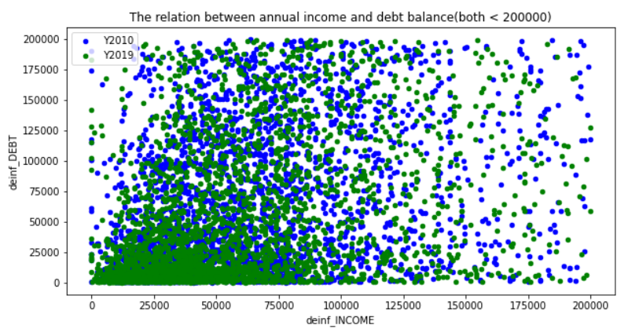
Hypothesis 1: The borrowers using Lending Club have worse economic situations than borrowers from all other lending resources
Is there any relationship between income and debt?
No.

Slide 16
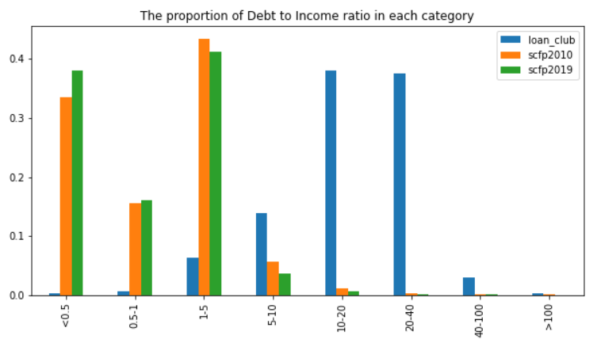
Hypothesis 1: The borrowers using Lending Club have worse economic situations than borrowers from all other lending resources
Debt-to-income ratio
40% General: D2I < 0.5
90% General: D2I < 1.5
90% club: D2I > 5
commercial banks D2I requirement: 0.43
lending club users have higher D2I than general

Slide 17
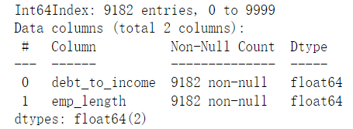
Hypothesis 2: The DTI (debt to income ratio) has negative correlations to the number of years that the applicant is in the job.
Data
Loans.csv
DTI
Years of Job
debt_to_income
emp_length

Slide 18
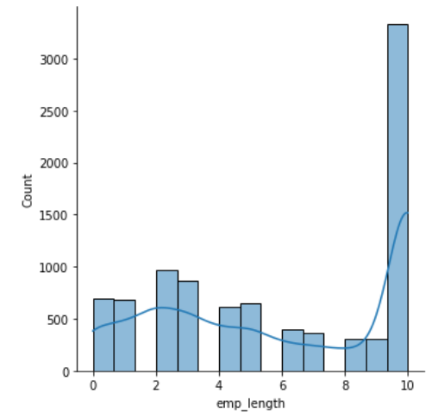
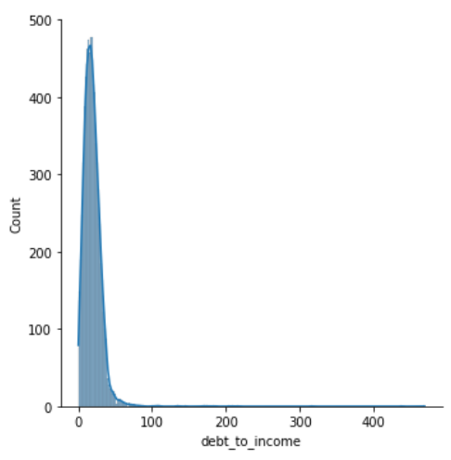
Hypothesis 2: The DTI (debt to income ratio) has negative correlations to the number of years that the applicant is in the job.
The Distribution of Two Sets
Too narrow with outliers
Year of work
DTI

Slide 19
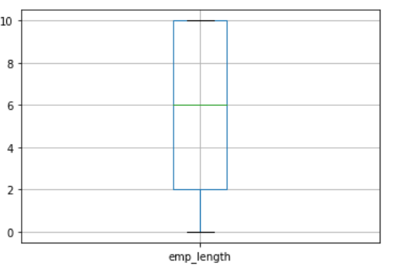
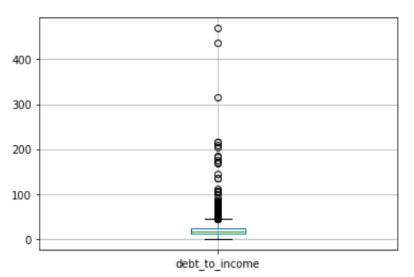
Hypothesis 2: The DTI (debt to income ratio) has negative correlations to the number of years that the applicant is in the job.
The Boxplot of Two Sets
Year of work
DTI
Delete Outliers

Slide 20
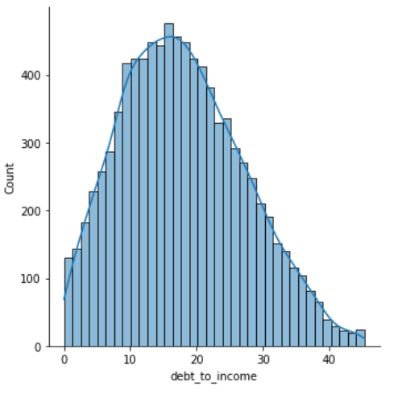
Hypothesis 2: The DTI (debt to income ratio) has negative correlations to the number of years that the applicant is in the job.
The Distribution of DTI after deleting outliers :
Correlation Method:
Years_of_work (emp_length col) are not satisfied with normal distribution
Using Spearman method to analysis relation between DTI and Years of work
Output correlation is 0.06, almost no relation
P-value is less than 0.05. We can see statistically significance
DTI

Slide 21
Hypothesis 2: The DTI (debt to income ratio) has negative correlations to the number of years that the applicant is in the job.
The Spearman Correlation output:
Conclusion for Hypothesis 2:
The DTI has nearly no relationship with number of years that the applicant is in the job
Problems:

Slide 22
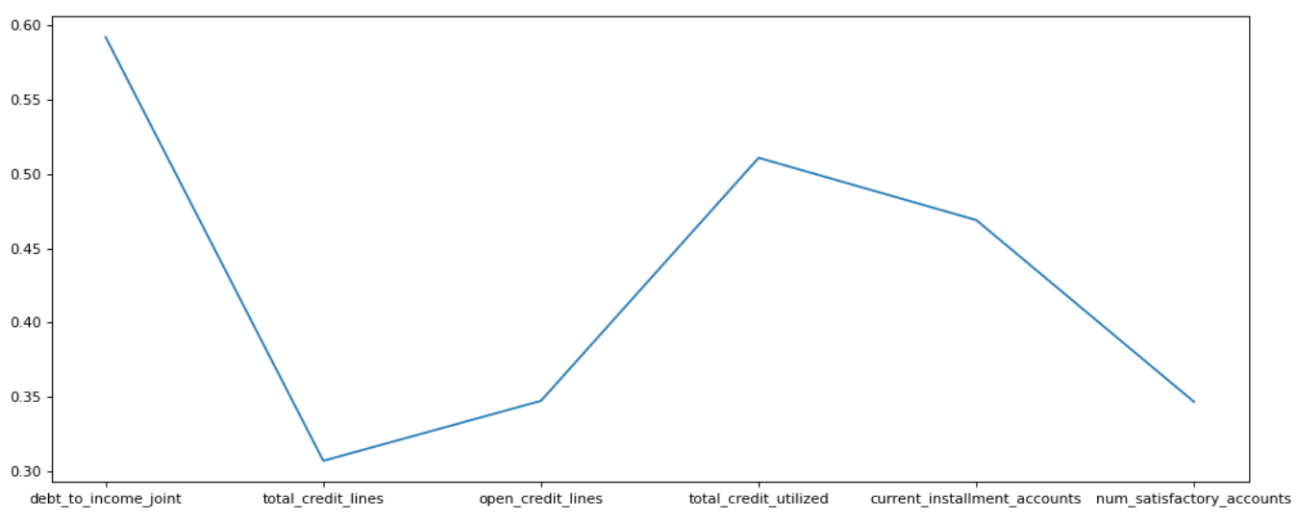
Hypothesis 2 & 3: Wrap Up
Which factors has reasonable relation with DTI ?

Slide 23
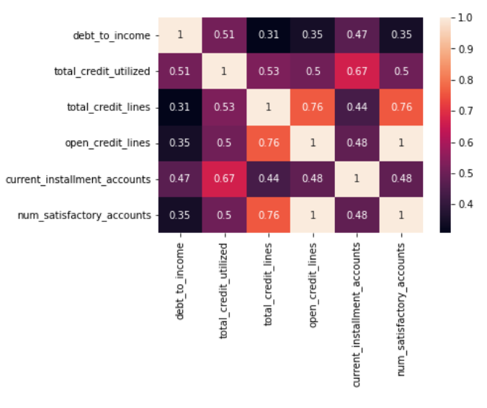
Hypothesis 2 & 3: Wrap Up
The heatmap of
big factors:

Slide 24
Hypothesis 3: People with higher annual incomes are more likely to make repayments on time.
Annual income
Continuous variable
Loan status
Categorical variable
Method for Hypothesis 3:
Spearman or Point-biserial

Slide 25
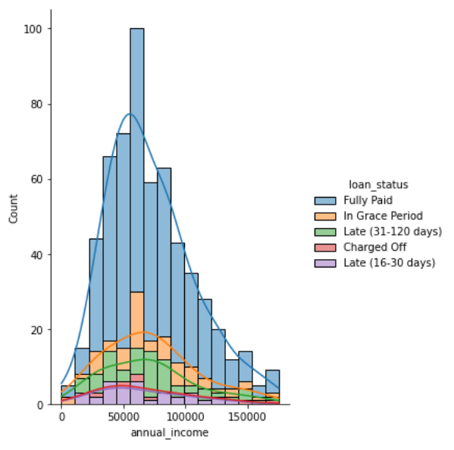
Hypothesis 3: People with higher annual incomes are more likely to make repayments on time.
Conclusion:
Output correlation is -0.01, almost no relation
P-value is much larger than 0.05. We can not see statistically significance
People’s annual incomes are not related to whether they are likely to make repayments on time

Slide 26
IS597 Final Project Presentation
Thank You for Listening!
Instructor: John Weible
Group members:
Chuyang Li, Yuting Xu, Zheng Zhang
Date: 4th May 2022

